Slide 1
CSP571 Data Preparation and Analysis
Lecture 1. Introduction
Oleksandr Narykov
onarykov@iit.edu

Slide 2
Introduction
Instructor
Oleksandr Narykov (onarykov@iit.edu)
TA
Harishekar Reddy Bobbili (hbobbili@hawk.iit.edu)
Office hours
Oleksandr Narykov – Thu, 11:30am-12:30pm, SB104
Harishekar Reddy Bobbili – TBD
Programming language: Python.
Libraries: pandas, scikit-learn
Notes:
Without assumptions you cannot make predictions
Declarative representations are different from the purely data-driven machine learning algorithms
They allow us to incorporate prior domain knowledge into generative model and separate it from

Slide 3
Course Description
Surveys industrial and scientific applications of data analytics with case studies
Explore ethical issues via case studies
Learn how to prepare data sets for analysis by cleaning and reformatting
GitHub: https://github.com/AlexandrNP/CSP571-2024
4

Slide 4
Topics
Introduction to Data Analysis
Data exploration
Regression
Unsupervised learning
Dimensionality reduction
Data visualization
Kernel methods
Generative learning
Discriminative learning
Neural networks
Graphical models
Notes:
Without assumptions you cannot make predictions
Declarative representations are different from the purely data-driven machine learning algorithms
They allow us to incorporate prior domain knowledge into generative model and separate it from

Slide 5
Textbook
There is no required textbook for the course
Recommended literature
An Introduction to Statistical Learning by Gareth James, Daniela Witten, Trevor Hastie, Robert Tibshirani, Jonathan Taylor
Visualization Analysis & Design by Tamara Munzner
6

Slide 6
Course Objectives and Outcomes
Learn to explore data
Derive fundamental algorithms starting from basic mathematical and probabilistic principles
Apply several algorithms to real-world datasets
Perform model and hyperparameter selection
Elaborate the limitations of ML models
9

Slide 7
GRADING
Assignments | 40%
Project | 30%
Midterm Exam | 15%
Final Exam | 15%
13

Slide 8
Assignments (40%)
5 – 7 assignments
Most assignments will have two parts
Written
Programming
Possible assignment topics
Linear regression
Naïve Bayes
Logistic regression
PCA
SVMs
Neural networks
Clustering
14

Slide 9
Project (30%)
One-month long project
Will consist of
Programming
A presentation document
A final report
Current idea (might change later)
Pick a reasonable size dataset
Conduct an analysis of several algorithms and prepare corresponding visualizations
15

Slide 10
Late Submission Policy for Assignments
5-minute grace period, without any penalty
One hour late -5 points
One day late -7 points
Two days late -12 points
After two days no submissions accepted except for cases where permission was granted BEFORE the deadline, or due to exceptional circumstances
16

Slide 11
Exams
A midterm (15%) and a final (15%)
Like written assignments
Probably via Canvas
Midterm exam date
October; date TBD
Final exam date
December 5 – 10
The date is TBD by the university
17

Slide 12
Academic honesty
https://web.iit.edu/student-affairs/handbook/fine- print/code-academic-honesty
18

Slide 13
Accommodations
Reasonable accommodations will be made for students with documented disabilities. In order to receive accommodations, students must obtain a letter of accommodation from the Center for Disability Resources
https://www.iit.edu/cdr
19

Slide 14
Data Analysis
47

Slide 15
Data
Data is a collection of discrete or continuous values that convey information, describing the quantity, quality, fact, statistics, other basic units of meaning, or simply sequences of symbols that may be further interpreted formally.
https://en.wikipedia.org/wiki/Data
19
This slide deck is partially based on the work from https://michael-franke.github.io/ and
Visualization Analysis & Design by Tamara Munzner

Slide 16
Data
Data is a collection of discrete or continuous values that convey information, describing the quantity, quality, fact, statistics, other basic units of meaning, or simply sequences of symbols that may be further interpreted formally.
https://en.wikipedia.org/wiki/Data
19

Slide 17
Data
Data is a collection of discrete or continuous values that convey information, describing the quantity, quality, fact, statistics, other basic units of meaning, or simply sequences of symbols that may be further interpreted formally.
https://en.wikipedia.org/wiki/Data
19

Slide 18
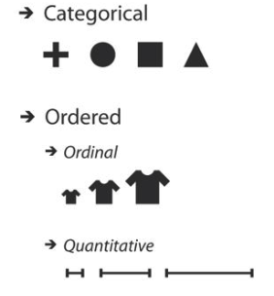
Data
Data is a collection of discrete or continuous values that convey information, describing the quantity, quality, fact, statistics, other basic units of meaning, or simply sequences of symbols that may be further interpreted formally.
https://en.wikipedia.org/wiki/Data
Quality: color, shape, name
Quantity: height, weight, temperature
19

Slide 19
Data
Data is a collection of discrete or continuous values that convey information, describing the quantity, quality, fact, statistics, other basic units of meaning, or simply sequences of symbols that may be further interpreted formally.
https://en.wikipedia.org/wiki/Data
Example: programming language, DNA sequence
19

Slide 20
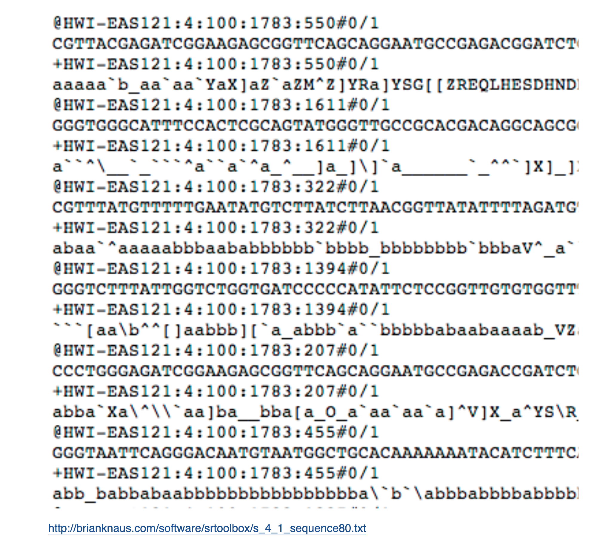
Data
19

Slide 21
Data Sources
Census (descriptive)
Observational study (inferential)
Convenience sample (all types - may be biased)
Randomized trial (causal)
Prediction study (prediction)
Studies over time
Retrospective (inferential)
Cross-sectional (inferential)
Longitudinal (inferential, predictive)
19

Slide 22
Dataset
Dataset, Population
19

Slide 23
Dataset
Measurement, Observation, Data Point
19

Slide 24
Dataset
Sample, Subset
19

Slide 25
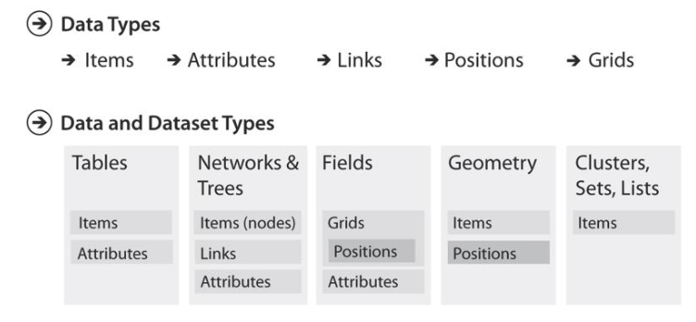
Datasets

Slide 26
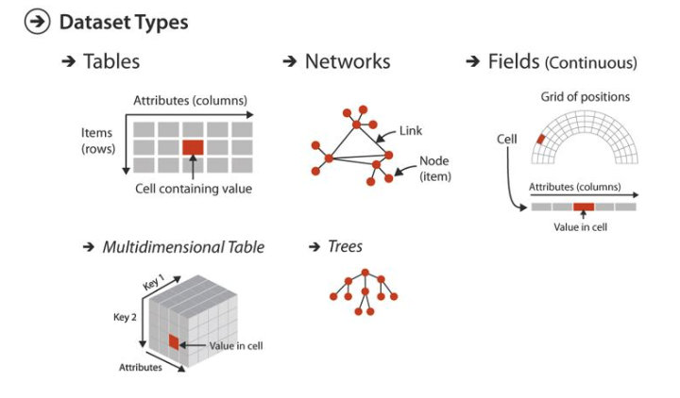
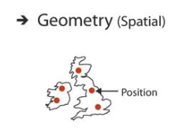
Datasets

Slide 27
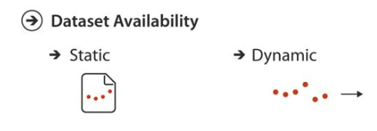
Datasets

Slide 28
Describing Data
Data is a collection, and humans cannot efficiently reason over large number of items
So, we have to summarize its properties
Summary statistic is a single number that represents one aspect of data
19

Slide 29
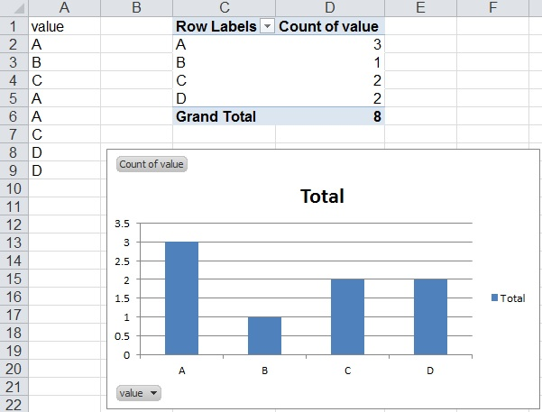
Counting
Count number of occurrences of the specific value
19

Slide 30
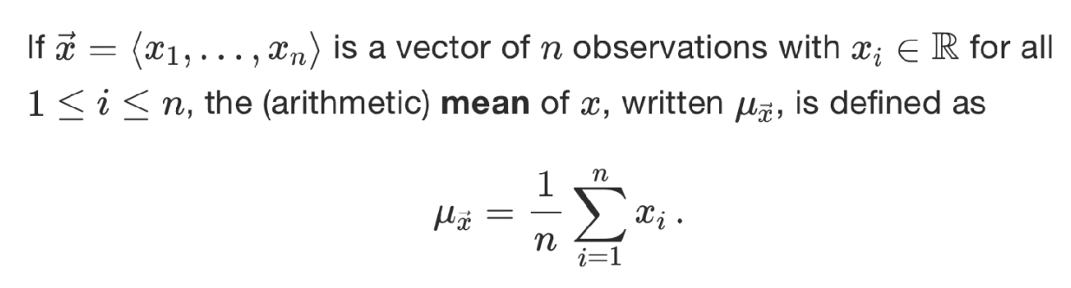
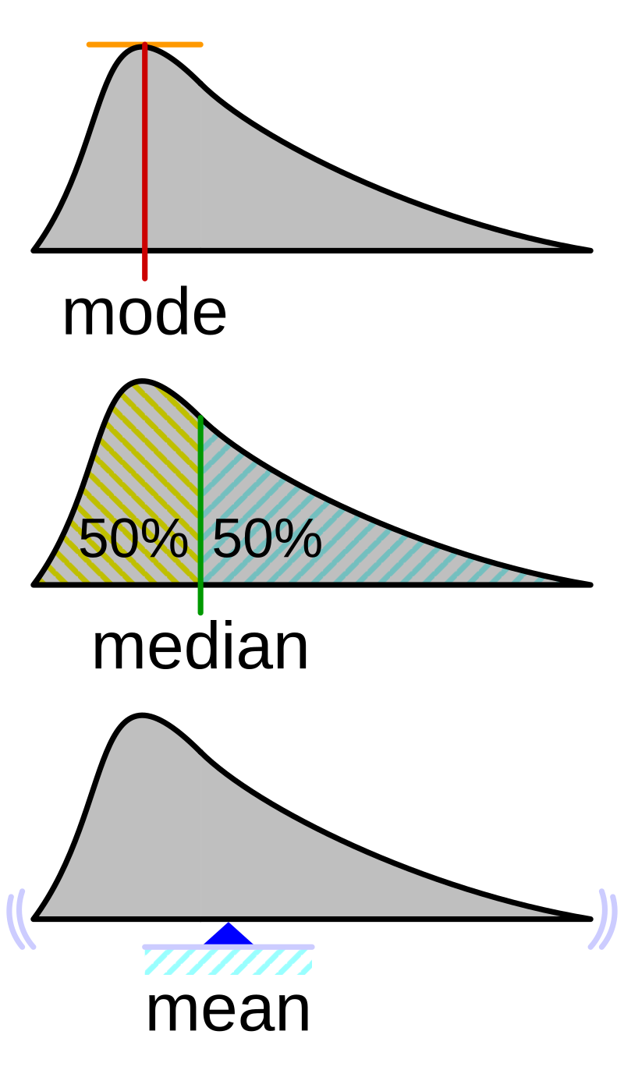
Mean
Count number of occurrences of the specific value
19
https://en.wikipedia.org/

Slide 31
Mean
19
https://en.wikipedia.org/

Slide 32
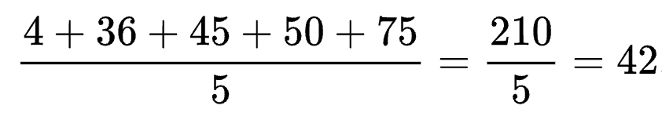
Mean
The arithmetic mean of five values: 4, 36, 45, 50, 75 is:
19
https://en.wikipedia.org/

Slide 33
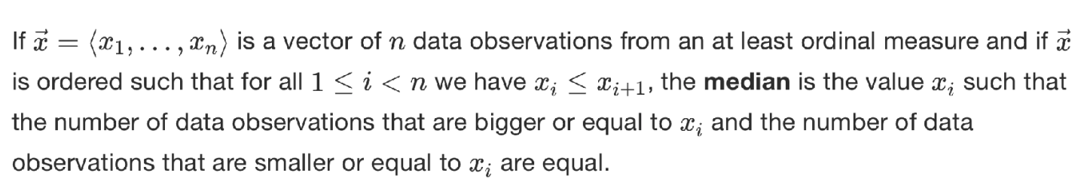
Median
19
https://en.wikipedia.org/

Slide 34
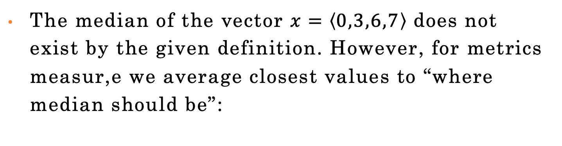

Median
The median of the vector $x=\left\langle 0,3,6,7\right\rangle$ does not exist by the given definition. However, for metrics measur,e we average closest values to “where median should be”:
$$\frac{3+6}{2}=4.5$$
19
https://en.wikipedia.org/

Slide 35
Mode
Mode is the value that occurs most frequently in the dataset
Good for qualitative variables
Quantitative variables should be binned
$$\frac{3+6}{2}=4.5$$
19
https://en.wikipedia.org/

Slide 36
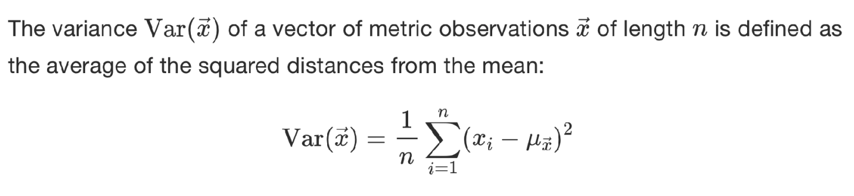
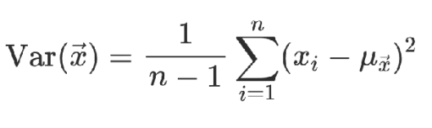
Variance
Biased
Unbiased
19

Slide 37
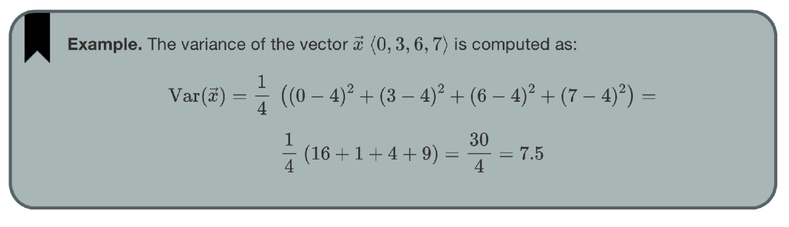
Variance
Example
19

Slide 38
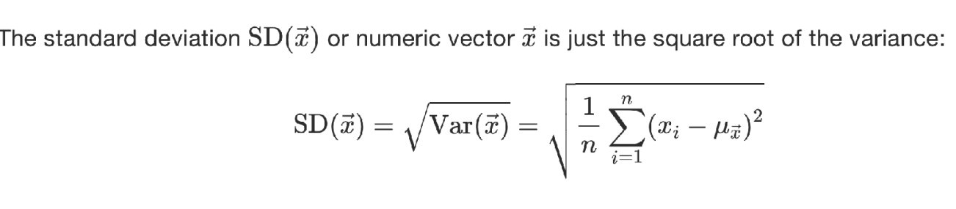

Standard Deviation
19
https://en.wikipedia.org/

Slide 39
Summary Statistics
Standard Deviation
19
https://en.wikipedia.org/

Slide 40
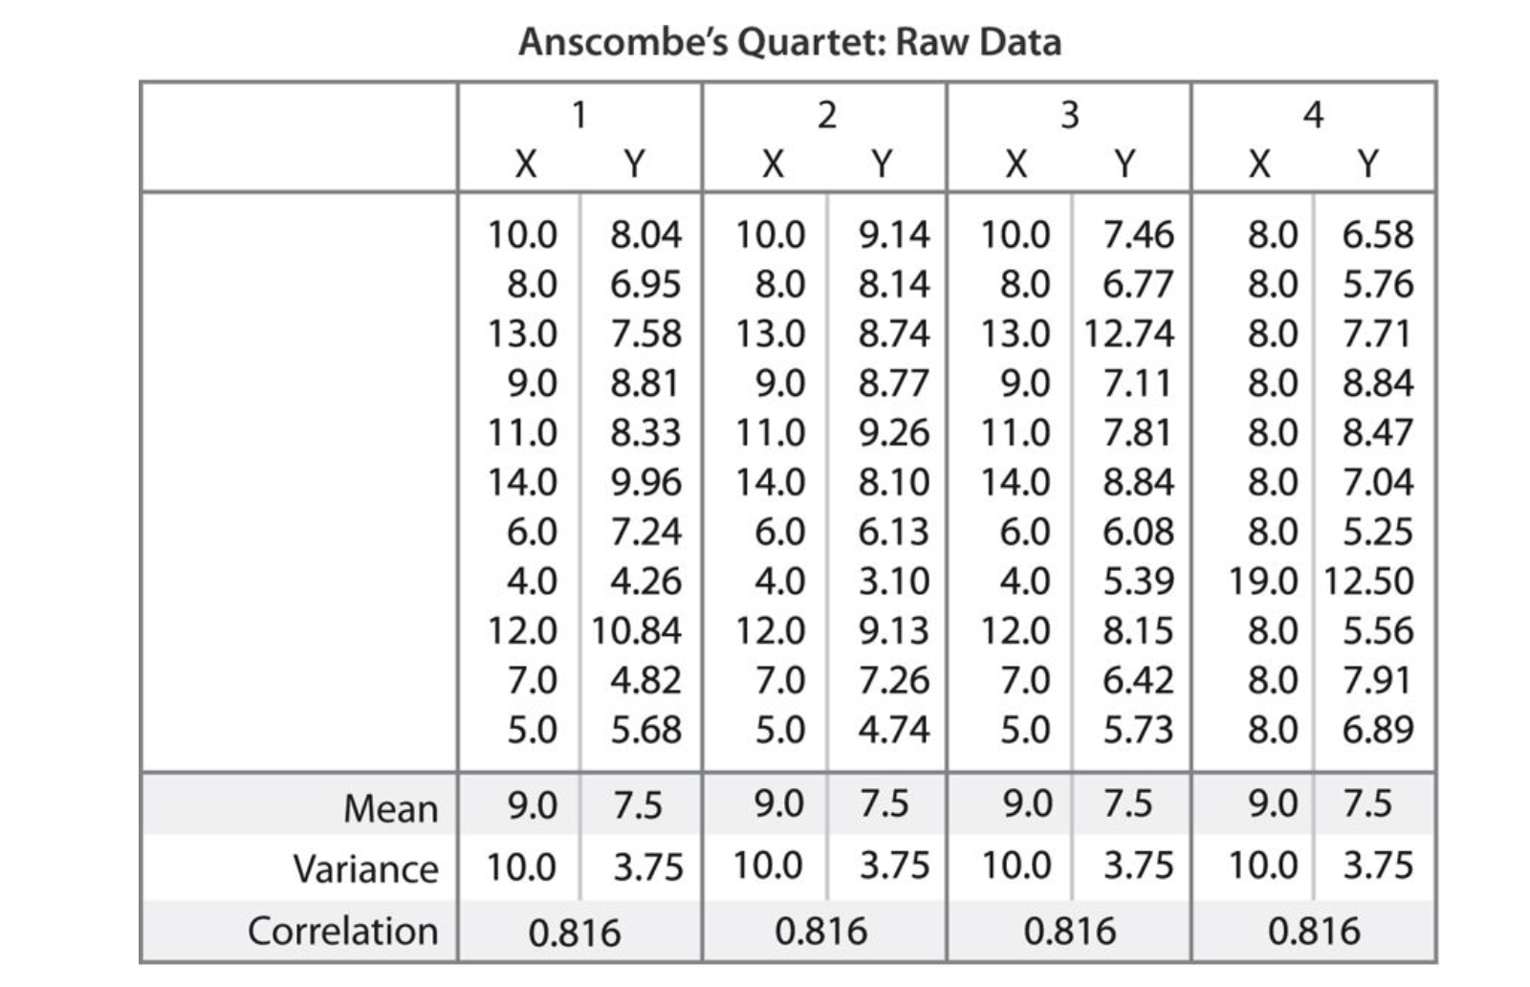
Describing Data
Datasets with identical mean and variance
19

Slide 41
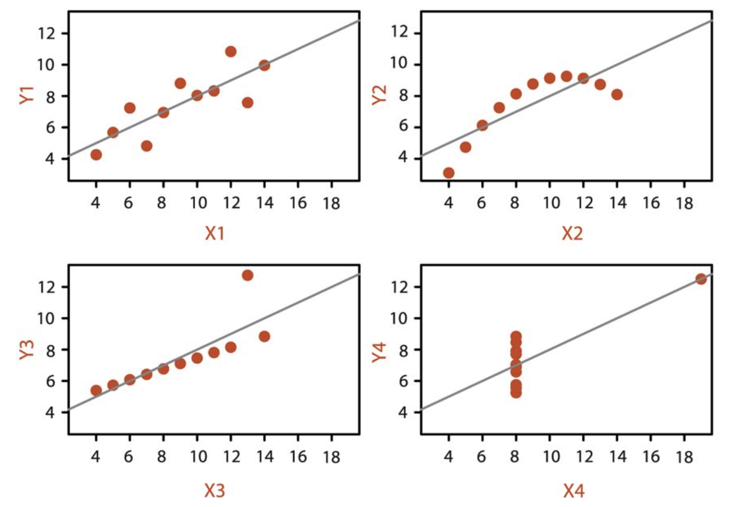
Describing Data
Actual data look very different
19

Slide 42
Reasoning over data
47

Slide 43
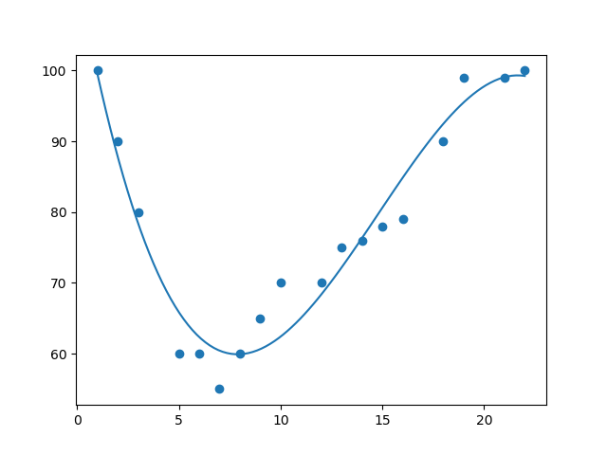
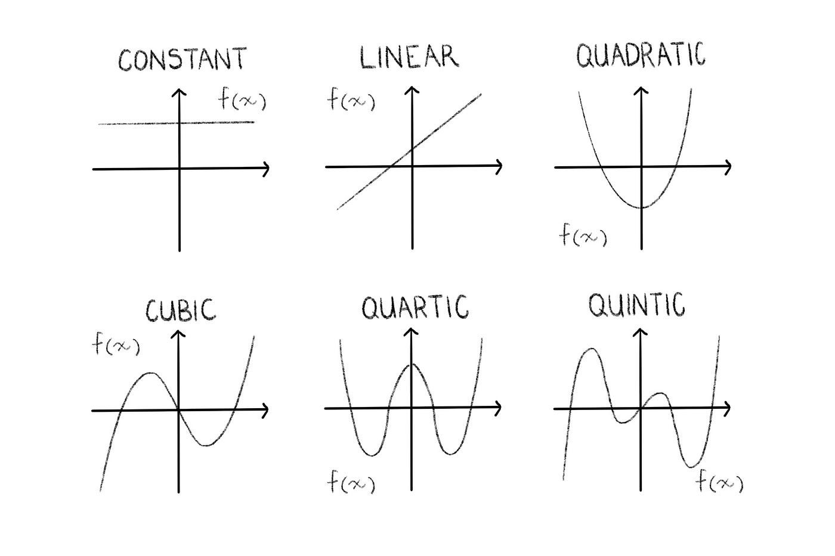
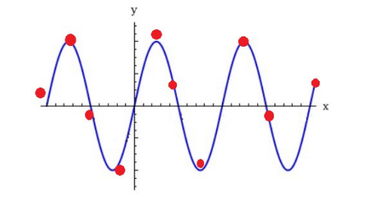
Data Space and Hypotheses
5

Slide 44
The Million-Dollar Question
What does the hypothesis even look like? What is the hypothesis space?
Is it
a logical formula of conjunctions (ANDs) and disjunctions (ORs)?
a set of rules?
a decision tree?
a linear additive function where each feature has its own weight, and it contributes one way or the other?
a non-linear function?
7

Slide 45
Is the Coffee Good?
You grind and brew your own coffee at home
You can control grind size, the amount of coffee, the water temperature, brewing time, etc.
For simplicity, let’s look at only the coffee amount and
the water temperature
Too little or too much coffee is not good
Too cold or too hot water is not good
What’s best depends on the person
You experiment with different coffee amounts and water temperatures and record your experience as positive or negative
48

Slide 46
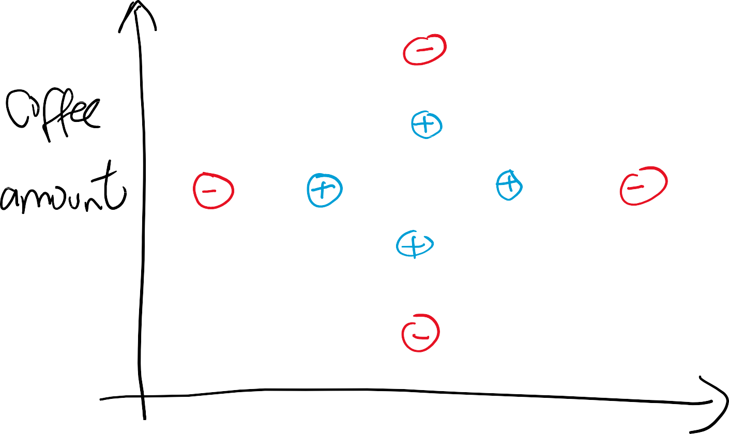

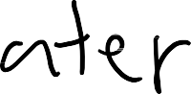
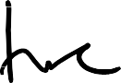


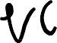
Experiment
49

Slide 47
Experiment
Assume the hypothesis space is the space of rectangles
That is,
ℎ 𝑎, 𝑡 = 𝑝𝑜𝑠𝑖𝑡𝑖𝑣𝑒 if 𝑎₁ ≤ 𝑎 ≤ 𝑎₂ and 𝑡₁ ≤ 𝑡 ≤ 𝑡₂
What are S, G, and version space based on the training data?
50

Slide 48
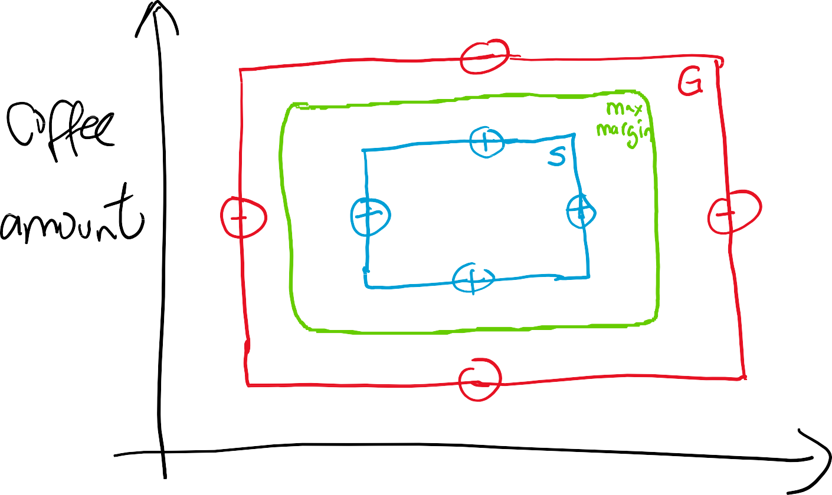

Version Space, Max Margin
51

Slide 49
Biased vs Unbiased Learning
In biased learning, we make assumptions about the hypothesis space
In unbiased learning, no assumptions are made
about the hypothesis space
Purpose of concept learning: generalize to unseen data
Unbiased learning simply memorizes the training data and it has no hope of generalizing to unseen data
46

Slide 50
Inductive Bias
We assumed that H is the conjunction of attributes. This is our inductive bias.
What happens when the target concept is not in H?
Can we avoid these problems by having a hypothesis space that has all possible hypotheses? That is, what if our hypothesis space is unbiased?
First, how big is such a hypothesis space?
Given n Boolean attributes, there are 2^{𝑛} possible examples
Each example can be a positive or negative example
Therefore, there are 2^{2𝑛} possible hypotheses!
Second, how useful are such hypotheses?
44

Slide 51
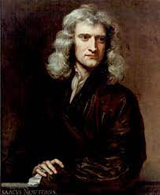
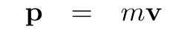
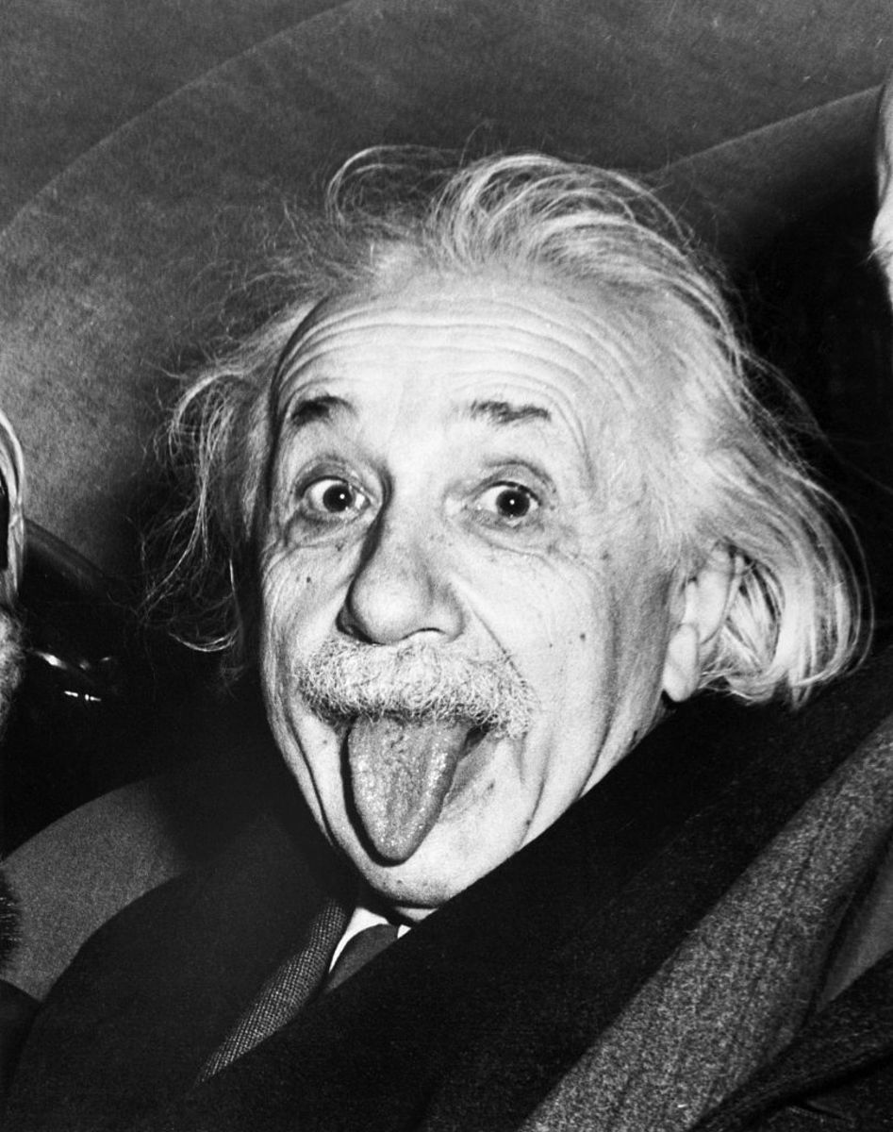
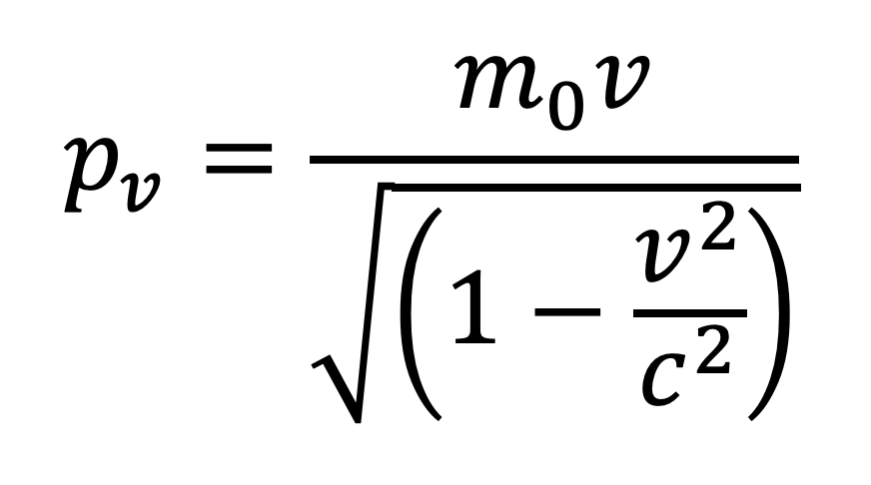
Modeling Data
“All models are wrong, but some are useful”
- George Box

Slide 52
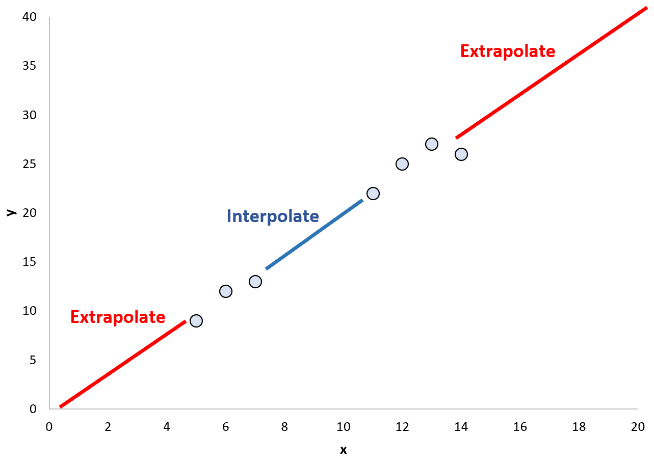
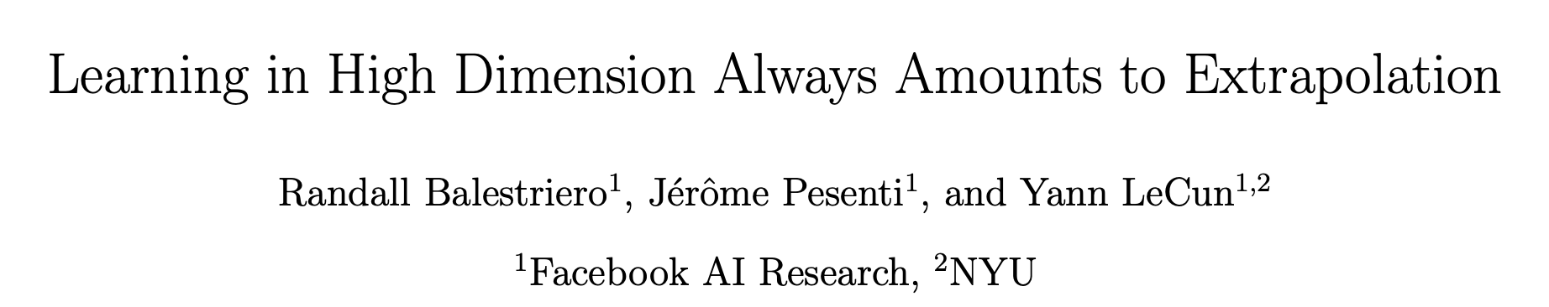
Possible Scenarios

